Slide 1
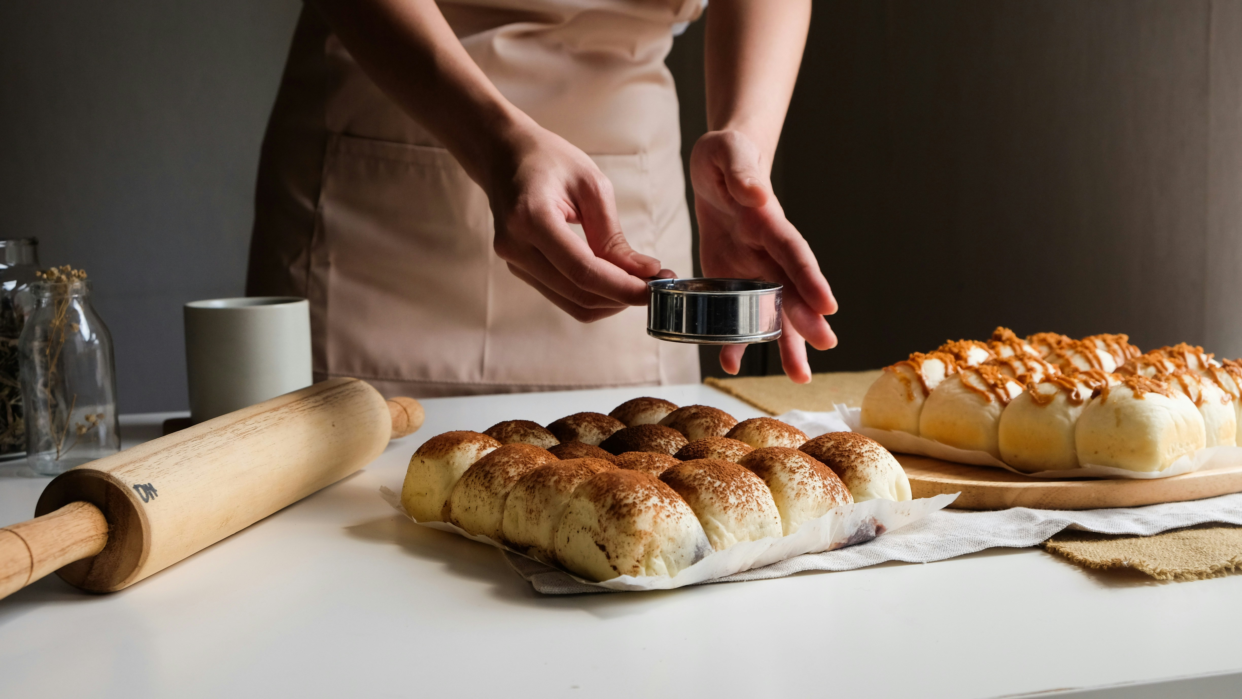
The Midnight
Kitchen
Baking and Sunday dinner playbook
Jane Sparks | Southern comfort baking

Slide 2
On the counter this season
What gets baked, and how often
1
The pantry, on hand against reorder
2
The holiday bake list and its progress
3
Sunday dinner, lighter for Linda
4

Slide 3
What gets baked
Bakes this season by type, results travel to the office Monday morning

Slide 4
Pantry and the holiday list
Item | On hand | Reorder
All-purpose flour | 10 lb | 4
Granulated sugar | 8 lb | 3
Unsalted butter | 6 lb | 3
Active dry yeast | 6 pk | 3
Pecan halves | 3 lb | 1
Cream cheese | 4 bk | 2
Cinnamon rolls and biscuits lead the list. Pecan pie and pound cake are saved for birthdays and holidays.
Holiday bake list, 6 of 9 done
67%

Slide 5
Sunday dinner, lighter for Linda
Watching sugar and carbs while the A1C comes down, comfort food that still feels like Sunday
Roast chicken with green beans and a small side salad
Low-sugar dinners this month
Baked fish with collard greens and roasted okra
3 of 4 Sundays
75%
Lean pork with sauteed greens and summer squash
Dessert is a lighter fruit option most weeks. The pound cake comes out for her birthday in November.
Turkey and vegetable soup with one slice of cornbread

Slide 6
Oven on, week handled
A midnight batch is the tell of a hard week, and the kitchen is where it settles.

